Slide 1
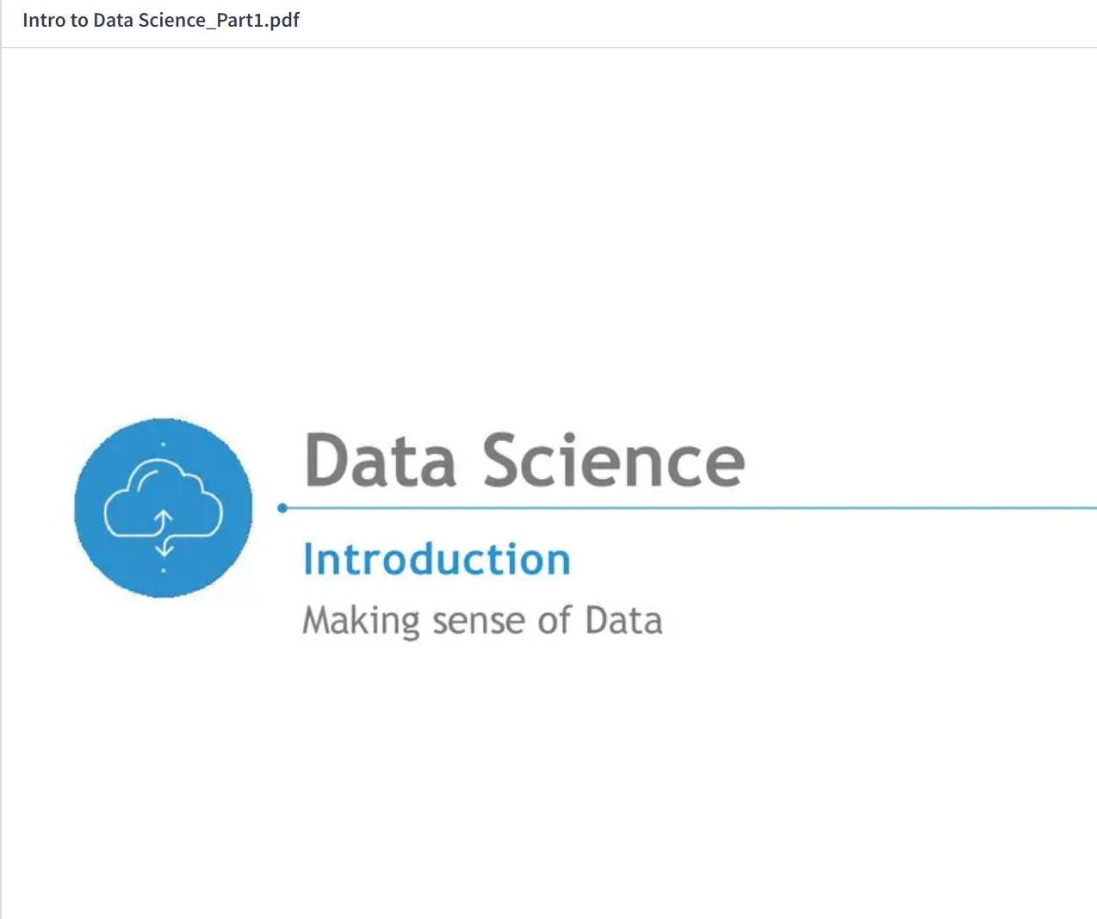

Slide 2
@amity1415

